Slide 1

Max Mustermann
Maria Musterfrau
⬥ Digital-Lotsen@ssg-sachsen.de 

Slide 2
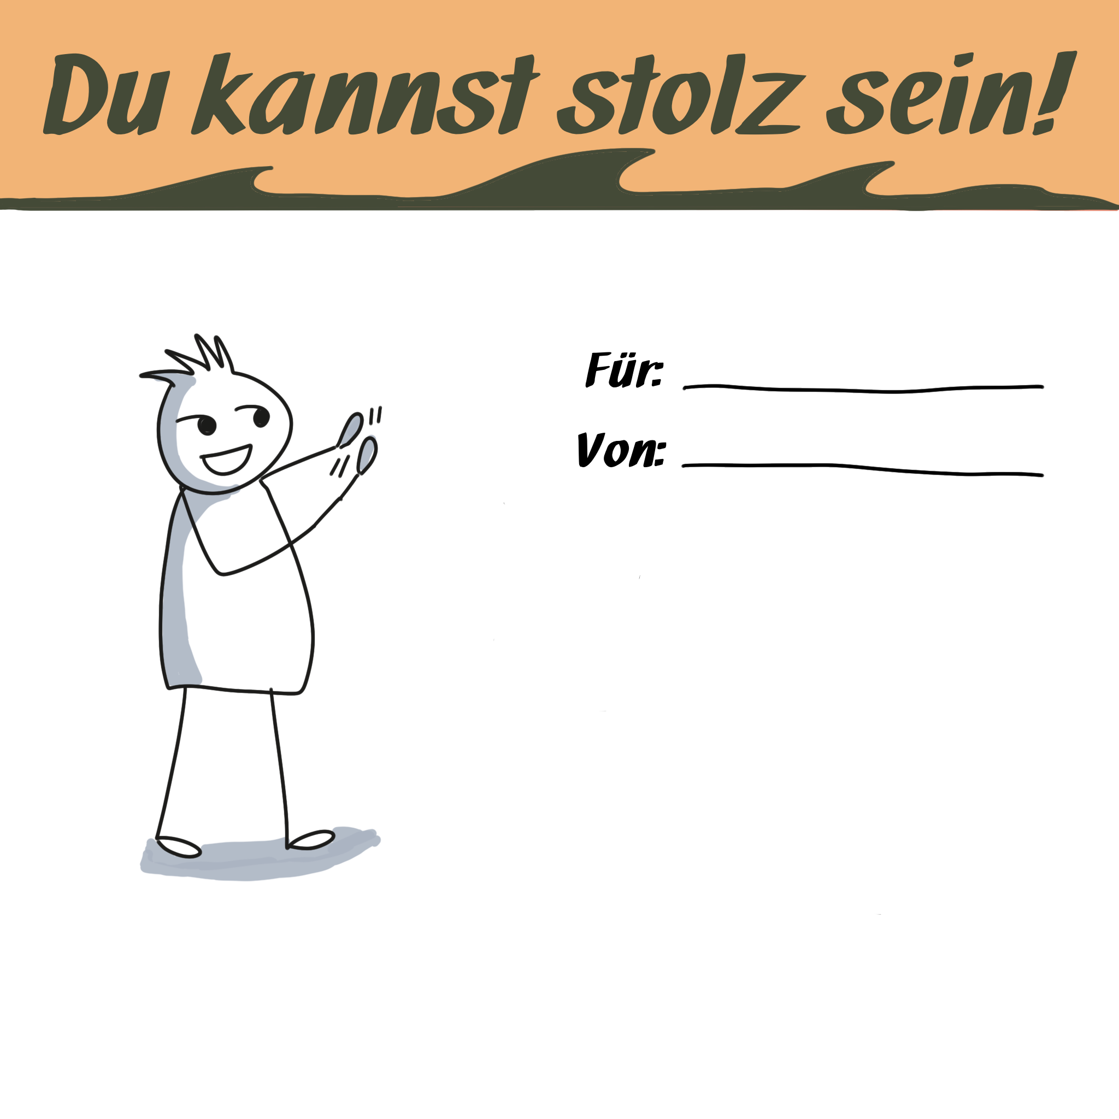
Max Mustermann
Maria Musterfrau
⬥ Digital-Lotsen@ssg-sachsen.de 

Slide 3

Max Mustermann
Maria Musterfrau
⬥ Digital-Lotsen@ssg-sachsen.de 

Slide 4

Max Mustermann
Maria Musterfrau
⬥ Digital-Lotsen@ssg-sachsen.de 

Slide 5

Max Mustermann
Maria Musterfrau
⬥ Digital-Lotsen@ssg-sachsen.de 

Slide 6
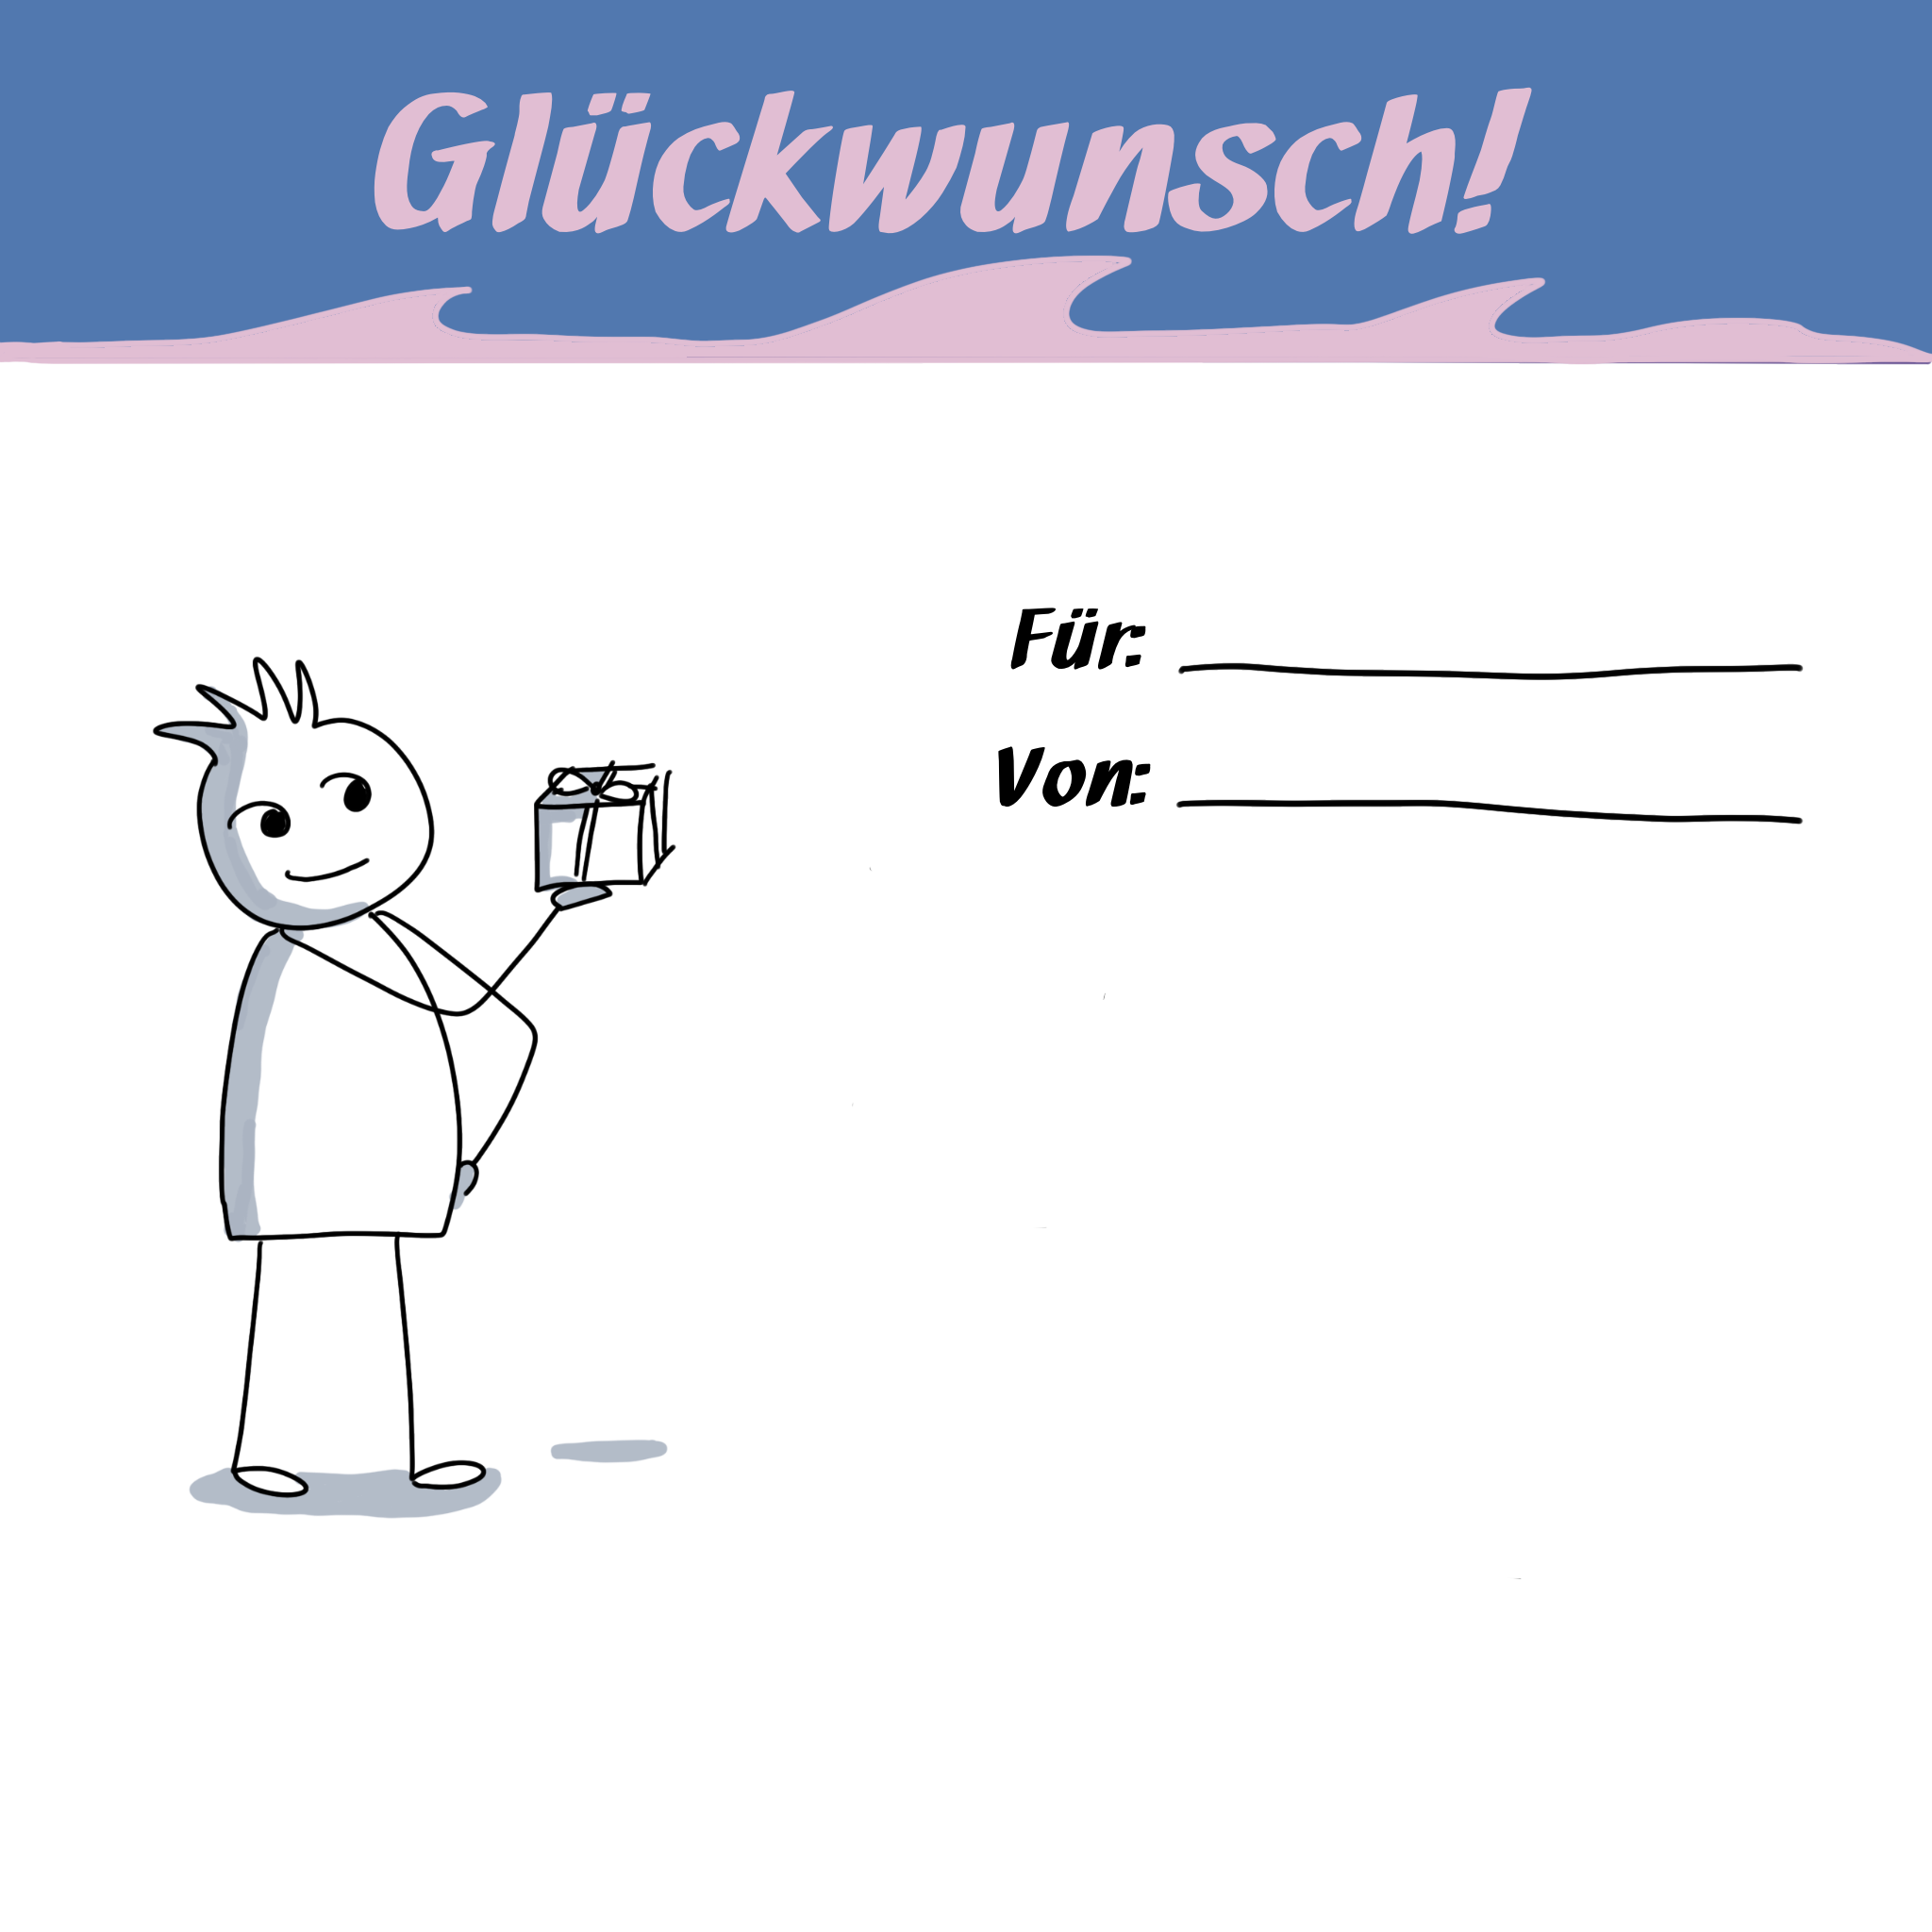
Max Mustermann
Maria Musterfrau
⬥ Digital-Lotsen@ssg-sachsen.de 

